Slide 1
Predicting soil moisture and temperature using regression analysis & PCA on hyperspectral data
Vicky Karkera
Notes:
12 slides

Slide 2
Problem Statement

Slide 3

Research Questions
(1) Can hyperspectral data be used to identify areas of soil with particularly high or low moisture content, which could be targeted for irrigation or other interventions?
(2) Can hyperspectral features be used to identify areas where plants may be at risk due to high or low temperatures?
(3) Can principal component analysis improve upon traditional statistical models for predicting soil moisture and temperature using hyperspectral data?

Slide 4
Experiment Setup

Slide 5
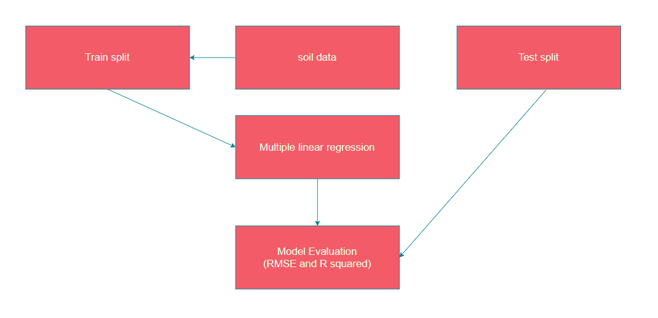
Methodology: Base Model

Slide 6
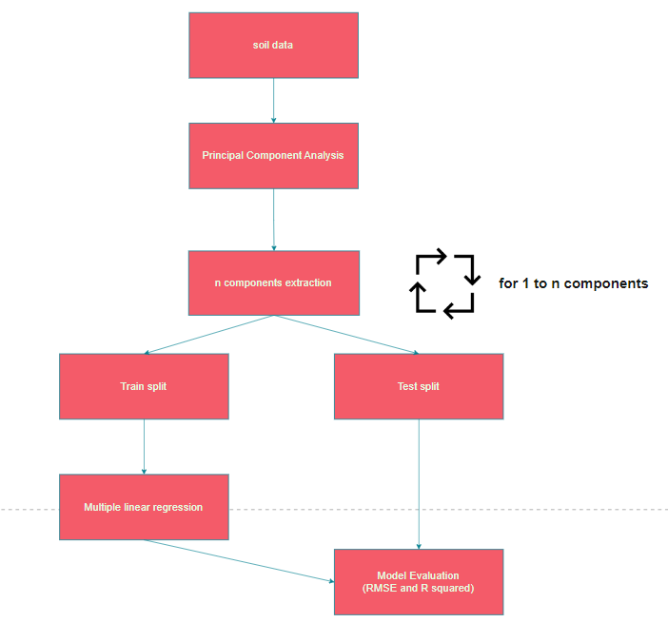
Methodology: Base Model

Slide 7
Results

Slide 8
Results: Tabular Summary
Multiple linear regression with and without PCA.
Model | Response variable
 | Soil moisture |  | Soil temperature
 | RMSE | R squared | RMSE | R squared
Linear Regression | 0.386 | 0.855 | 0.473 | 0.790
Linear Regression + PCA (optimal) | 0.334 (40) | 0.888 (40) | 0.383 (38) | 0.852 (38)

Slide 9
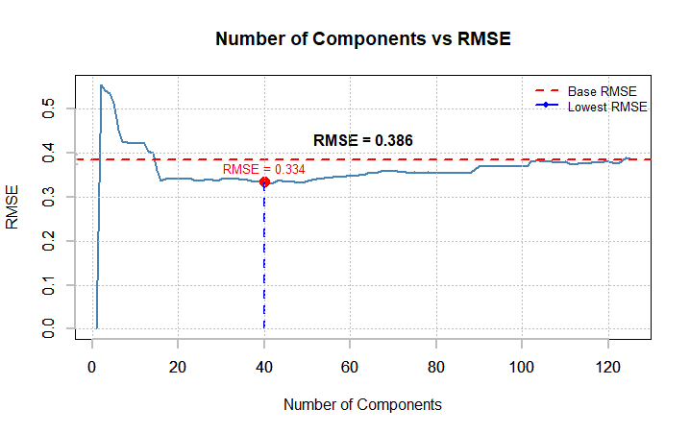
Results: Graph for soil moisture prediction
RMSE vs number of Principal Components

Slide 10
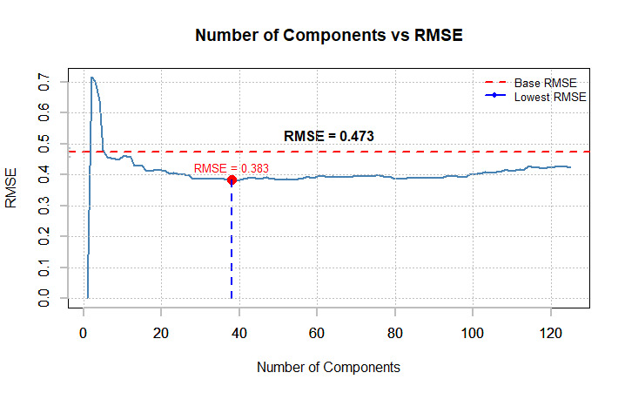
Results: Graph for soil temperature prediction
RMSE vs number of Principal Components

Slide 11
Conclusion

Slide 12
Conclusion
In conclusion, our experiment aimed to investigate the relationship between soil moisture and soil temperature with regards to various hyperspectral features.
We performed multiple linear regression analysis and subsequently applied principal component analysis (PCA) for dimensionality reduction to improve the predictive performance of the regression models.
These findings highlight the usefulness of PCA in reducing dimensionality and selecting informative components for regression analysis.
Overall, our experiment demonstrates the effectiveness of PCA in improving the predictive performance of a multiple linear regression model for soil moisture and soil temperature prediction using hyperspectral features. These findings have implications for soil science, agriculture, and environmental monitoring, providing insights into the relationship between soil moisture and spectral characteristics for improved understanding and management of soil systems.

